Slide 1
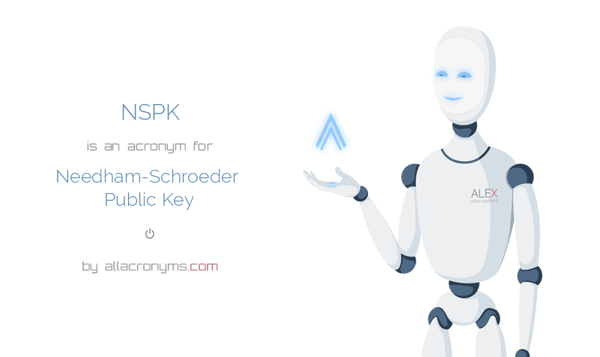
NEEDHAM-SHCHROEDER
an authentication protocol
BY:-
GROUP 4
B-TECH CSE(EVENING)
6CSEY

Slide 2
INTRODUCTION:-
Needham-Schroeder is a shared-key authentication protocol that has been very important historically.
This protocol helps in protecting the password which is in the form of the secret keys which is very urgent in the ancient times when there is urgent need for the protecting software.
This protocol helps by saving the key like an password and send it at most once to the receiver for very short time.
In this process there is two type of processes which is going simultaneously one is sending the key and other is receiving the key while it is doing the another work simultaneously.

Slide 3
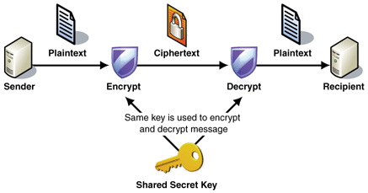
SECRET KEY’S CONCEPT IN NEEDHAM:-
A process acting on behalf of a principal A that wishes to initiate secure communication with another process acting on behalf of a principal B can obtain a key for this purpose. The protocol is described for two arbitrary processes A and B, but in client-server systems, A is likely to be a client initiating a sequence of requests to some server B. The key is supplied to A in two forms:
one that A can use to encrypt the messages that it sends to B and one that it can transmit securely to B.
The secret key is used only to authenticate client processes to the authentication server and to transmit messages securely between client processes and the authentication server. It is never disclosed to third parties and it is transmitted across the network at most once, when it is generated.
A secret key is the equivalent of the password used to authenticate users in centralized systems. For human principals, the name held by the authentication service is their username and the secret key is their password. Both are supplied by the user on request to client processes acting on the user’s behalf.

Slide 4
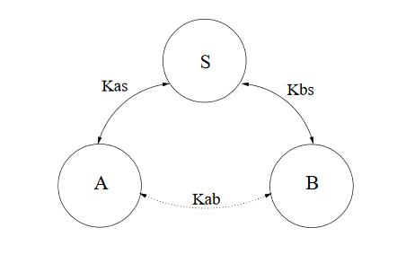
ARCHITECTURE
There are three principals: A and B , two principals desiring mutual communication, and S , a trusted key server.
It is assumed that A and B already have secure symmetric communication with S using keys Kas and Kbs , respectively.

Slide 5
Goals of the protocol:-
Goal of the protocol is to establish mutual authentication between two parties A & B ,it will be done in the presence of the advisory who can:-
->Intercept messages
->Delay Messages
->Generate Messages
Secret keys of principals which they share authentication with the server “S”.
This protocol use share key encryption /decryption.

Slide 6
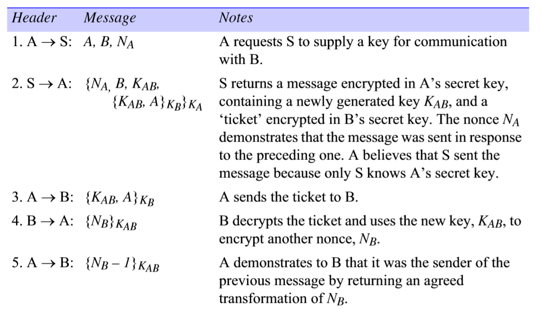
WORKING OF THE PROTOCOL:-

Slide 7
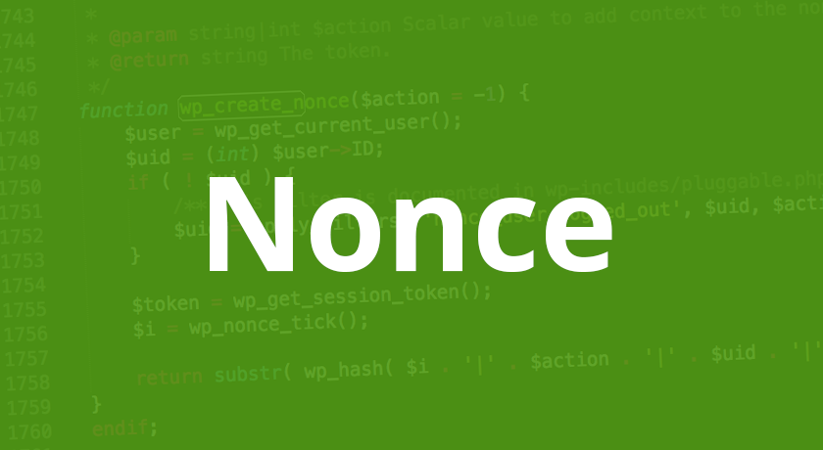
Nonces and timestamps in protocol:-
A nonces is an integer that is added to a message to demonstrate its freshness.Nonces are used only once and are generated on demand. If the protocol is successfully completed both a &b can be sure that any messages encrypted in Kab that they receive from others.
A timestamp is a unique identifier created by the DBMS to identify a transaction. Typically, timestamp values are assigned in the order in which the transactions are submitted to the system, so a timestamp can be thought of as the transaction start time.

Slide 8
Problems with NEEDHAM-SCHOEDER:-
Danning and Sacco pointed out that the compromise of Secret key has bad consequenses.
An intruder can reuse an old Session Key and pass it off as a new one all though ot was fresh.
There is now way for B to know if Kab it receives is current .
An intruder has unlimited time to crack an old session Key & reuse it as if were fresh.
An employ working in the company is fired can still log on to all of the company’s server.

Slide 9
MADE BY GROUP 4:-
1-MAYANK JAIN
2-GOURAV CHANDRA UPADHAYAY
3-SHYAM SAINI
4-ABHINAV KUMAR
5-RASHMI JAIN
6- ROHIT KUMAR SINGH
7- SOURABH GAUTAM

Slide 10
thank you

